Slide 1




SOCIAL ENGINEERING SIMULATION FOR CYBERSECURITY AWARENESS
Internship Project by Sabnam Banu
B.Tech, CSE | UPES Dehradun
Inlighn Tech | Mentor: Mr. Rishav Patel

Slide 2
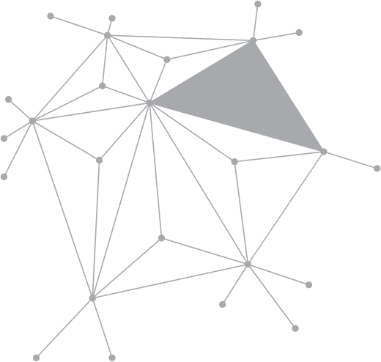


INTRODUCTION
Social engineering manipulates human trust.
Phishing is the most common attack vector.
Goal: simulate and measure awareness.

Slide 3

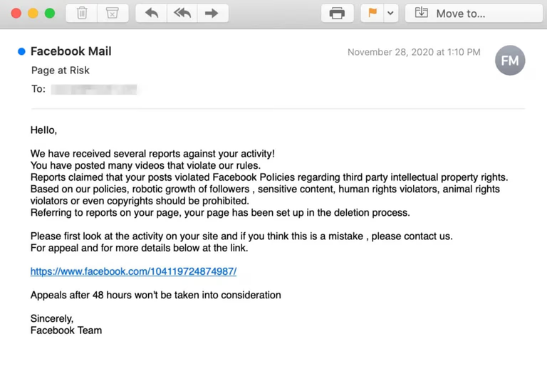
OBJECTIVES
Ethically simulate phishing-style email.
Observe awareness levels among participants
Suggest preventive measures.

Slide 4



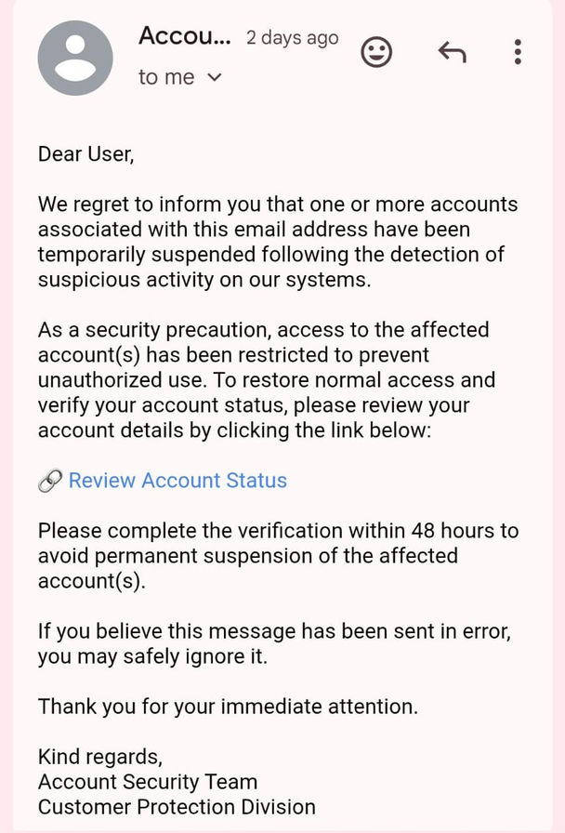


METHODOLOGY
Designed a harmless phishing email.
Analyzed responses using Python & Sheets.
Linked to safe landing page (Google Sites).
Collected data through Google Forms.

Slide 5
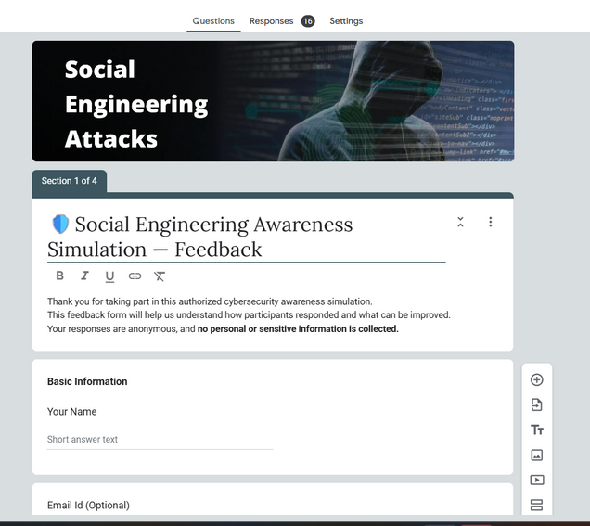
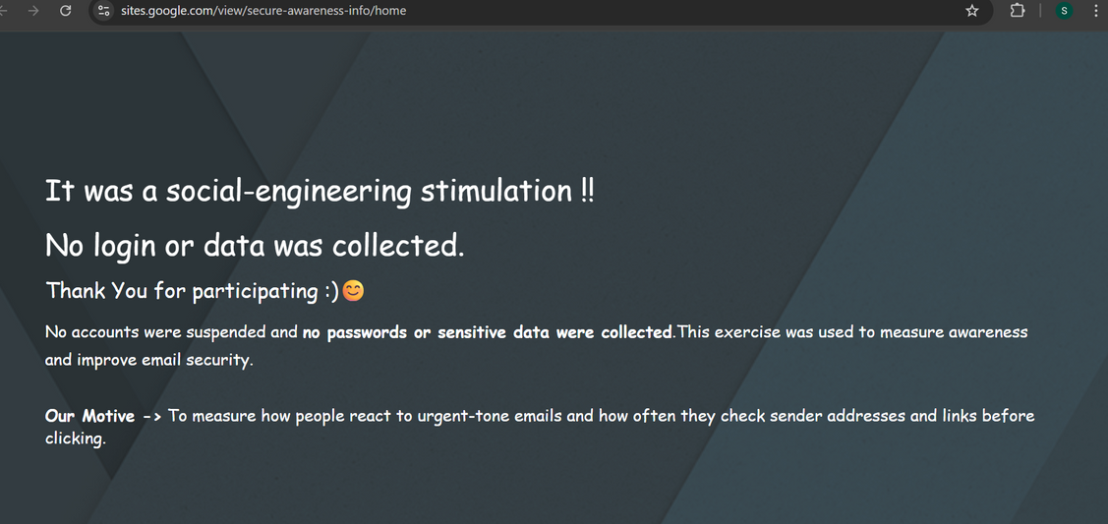
TOOLS & TECHNOLOGIES USED
Google Forms – Feedback collection
Google Sites – Landing page
Mailmeteor – Email distribution
Python (Matplotlib, Pandas) – Analysis
MS Word / Canva – Documentation

Slide 6
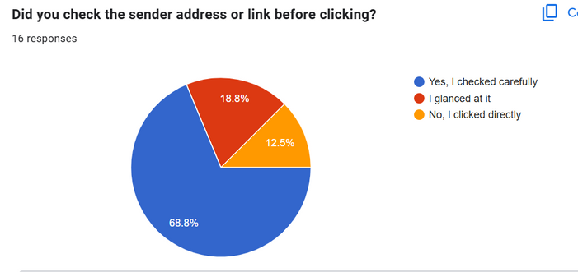
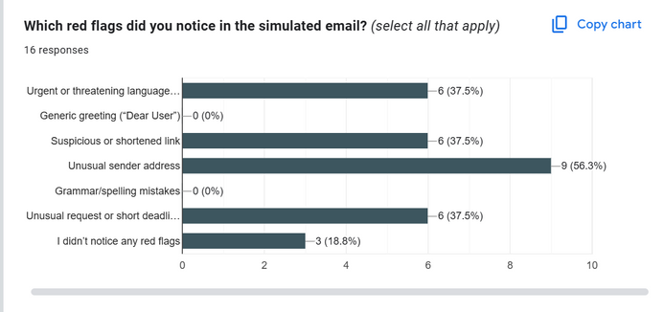
RESULTS
Total Participants: 16
70% verified sender before clicking.
Common red flags: fake sender, urgency.
Some users clicked without checking.
Average realism score: High (4.1/5).

Slide 7

FINDINGS & RECOMMENDATIONS
Awareness is good but not perfect.
Emotional urgency still misleads users.
Regular training and simulations recommended.
Short awareness modules improve outcomes.

Slide 8
CONCLUSION
Simulation improved participant awareness.
Realistic phishing tests strengthen cyber hygiene.
Continuous education builds long-term security awareness

